Slide 1


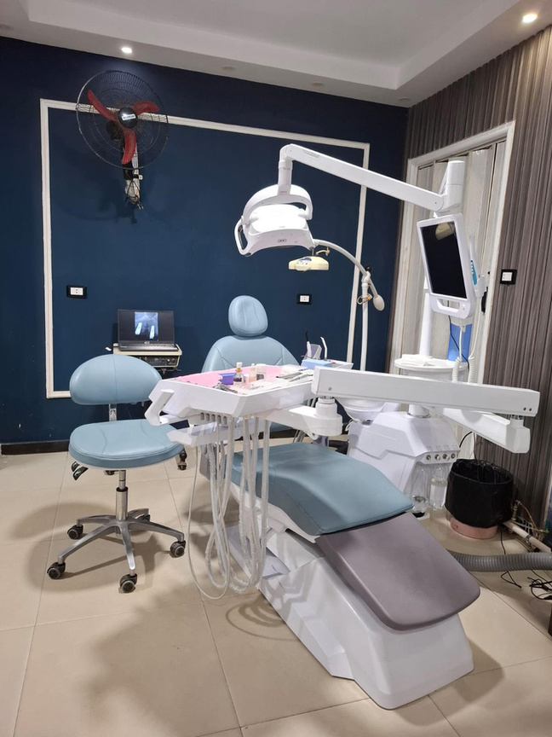
Digital Marketing Specialist Graduation Project
Team Members
Doaa Fathi AbdelAziz
Heba Ahmed Hassan
Yassmin AbdEl-Maboud Nassar
Fatma Mohamed ElKerdawy
Shaimaa Aly Ahmed
1
GROUP INSTRUCTOR
ENG. SAFY ELDIN AHMED

Slide 2
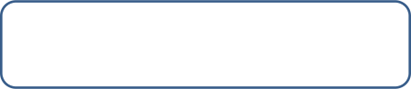



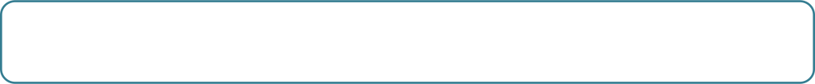



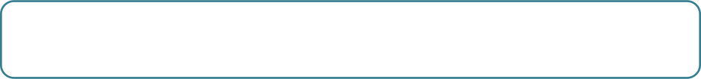
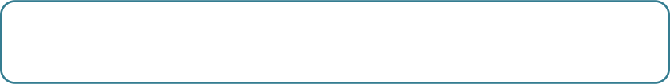


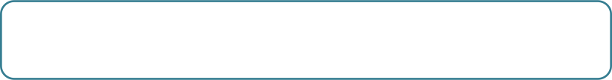


Content
1
Introduction
- Introduction -Vision and Mission - Applications
- Team roles - BMC - SOSTAC Model
2
Situation Analysis
-SWOT analysis -Competitors analysis
–Customers analysis
3
-Objectives
Objective Settings
Strategy
4
- USP -Buyer Persona -GANNT chart
-Strategy timeline
5
-Platforms - Ads -Content calendar
Tactics
6
Action
- Posts types - Post samples, content,
videos, reels and stories samples
7
Control
KPIs - Campaign Management
- Recommendation

Slide 3

Introduction
3

Slide 4

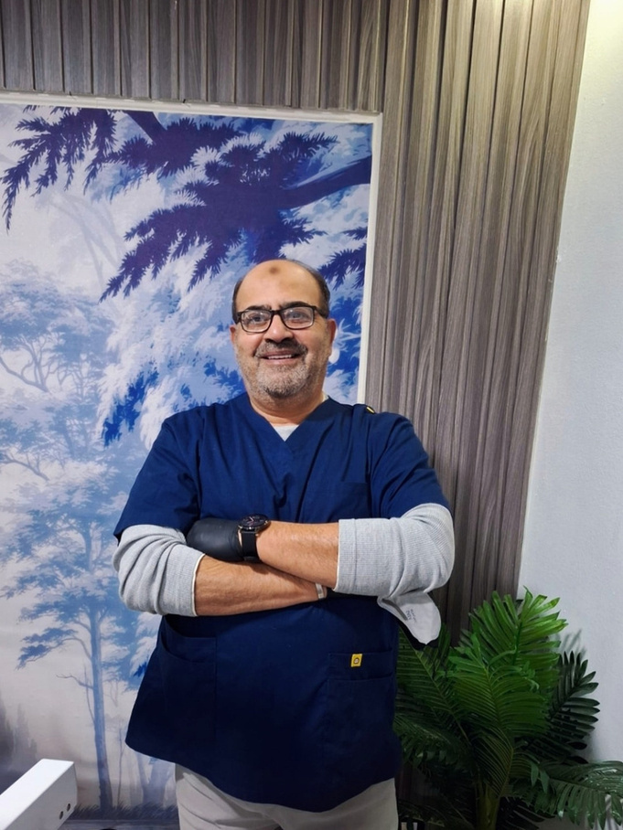
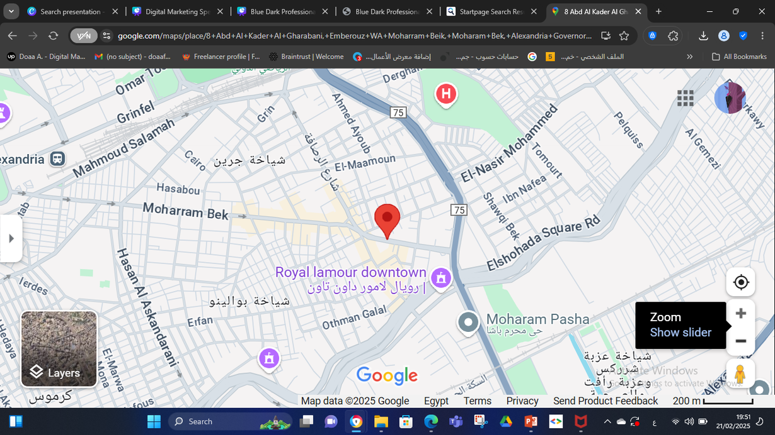
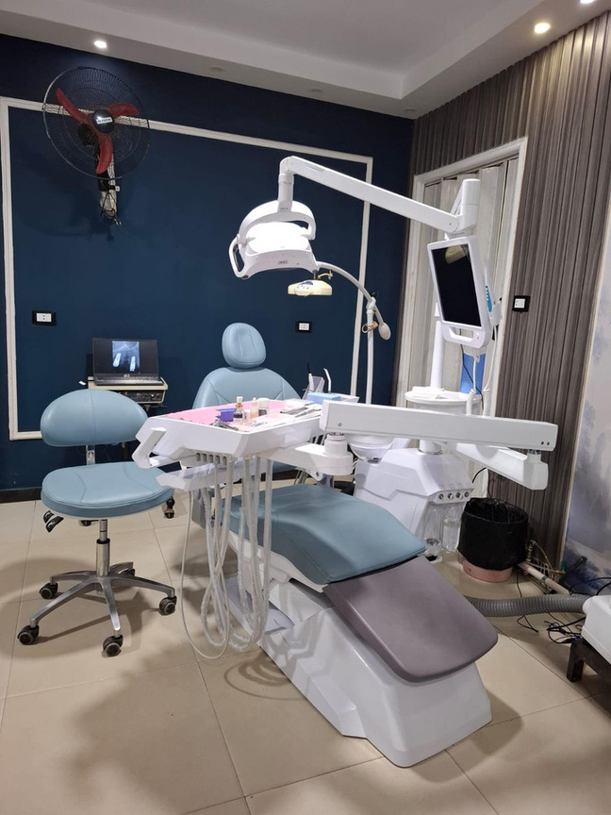
Introduction
We hold a digital marketing strategy for a Dental Clinic in Moharam-Bek , ALexandria for Dr. Ahmed Saeed Hammad, The page of the clinic was created on 2018 and was pause on 2019. We started working on the page starting from December 2024 to increase page followers and increase awareness.
4

Slide 5



VISION AND MISSION
VISION:
Our vision is to deliver advanced, patient-centered dental care in a welcoming and innovative environment.
MISSION
To establish a trusted digital presence that educates, engages, and builds long-term patient relationships while enhancing the clinic's reputation and achieving sustainable community growth.
5

Slide 6
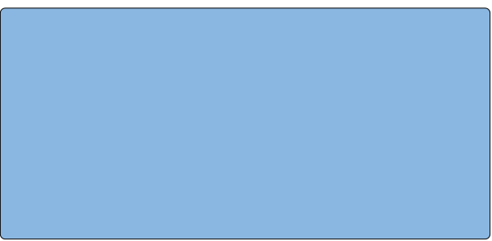
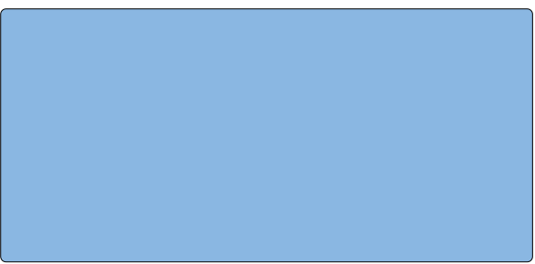
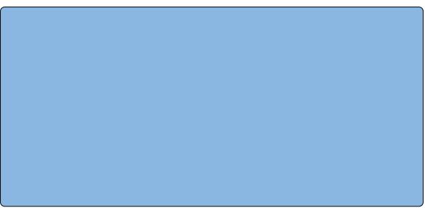
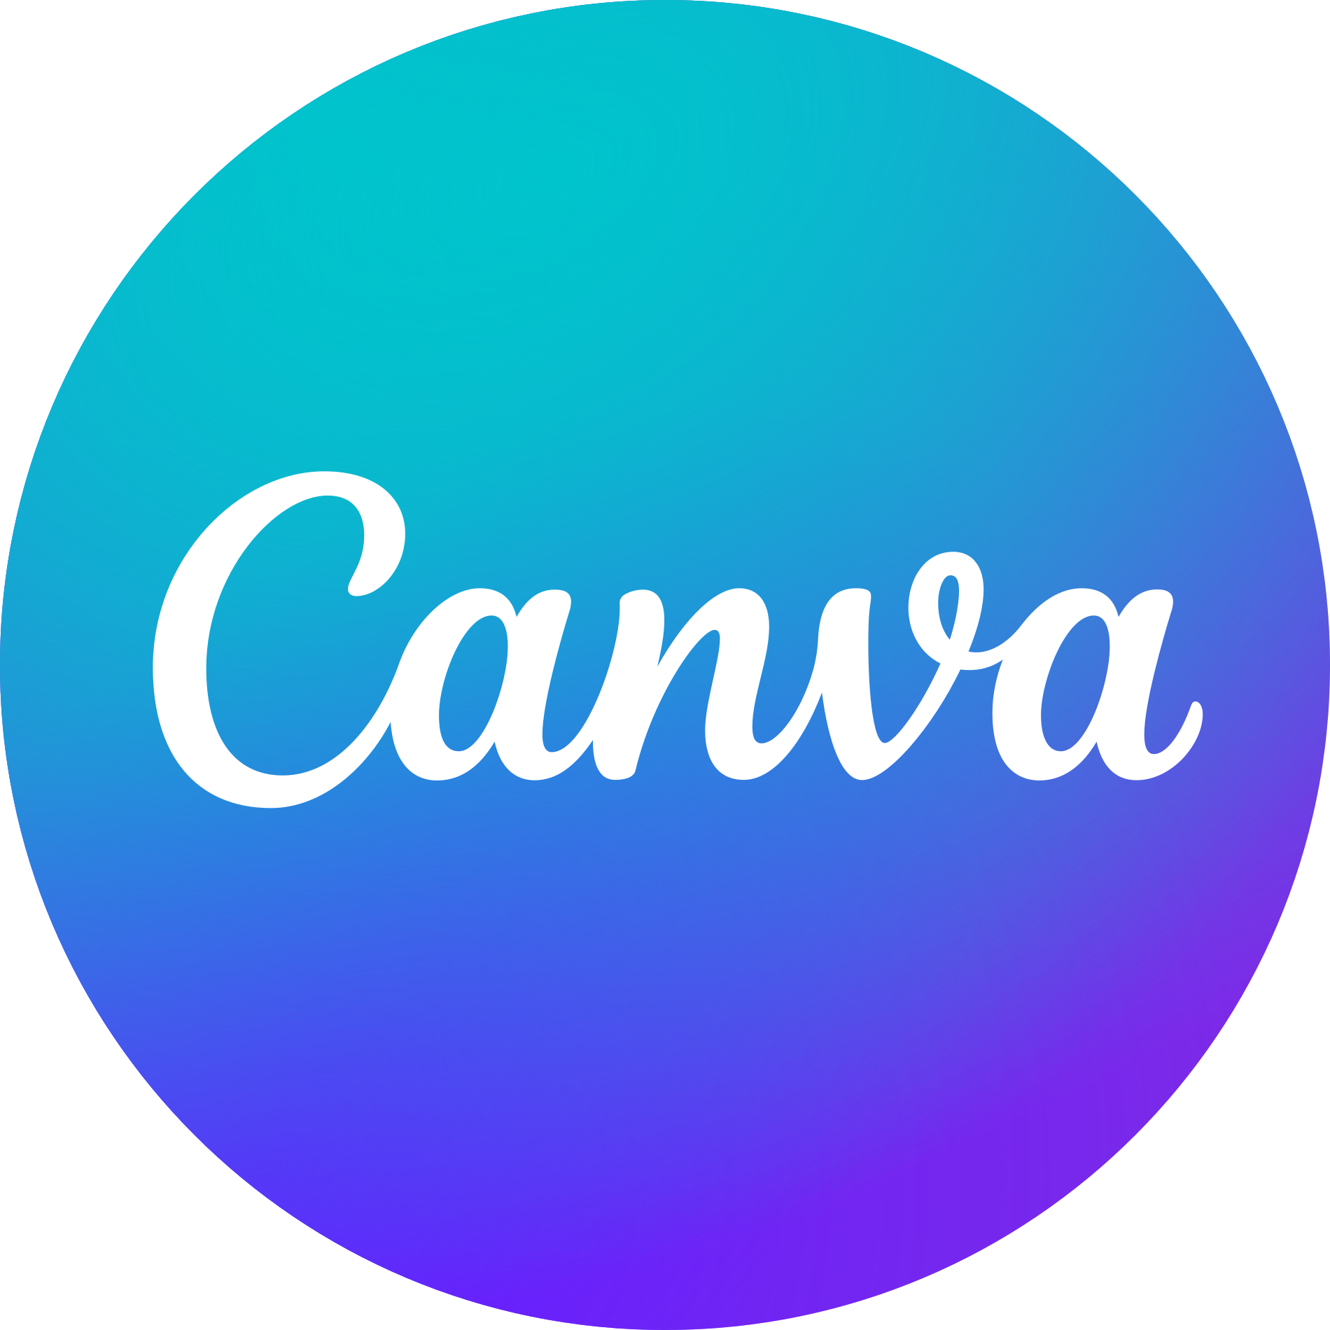


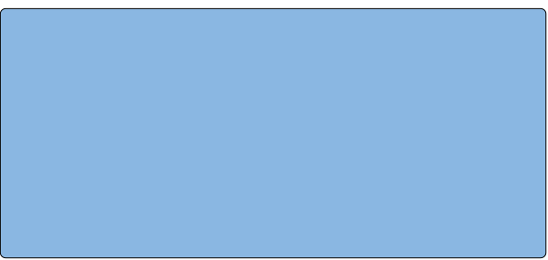
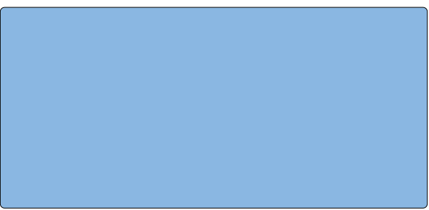
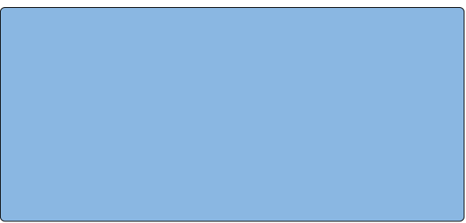


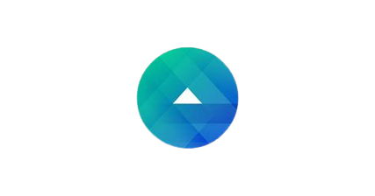





Applications used
We used these applications, tools and sites during the projects steps
Canvas:
For designing social media posts, videos and ads creative
Fanpage Karma:
Used for
competitor analysis
Meta Business Suite:
For managing and scheduling Facebook and Instagram posts
Google drive
Used for storing reports, presentations , content plans and sharing files.
Capcut:
For editing videos and promotional videos
Meta Ads Manager:
For running Facebook and Instagram Ads
6
Google trends :
For making charts and calculation
PowerPoint :
For making the presentation
Githup:
For uploading the presentation
Notes:
1.7.2013
6
‹#›

Slide 7

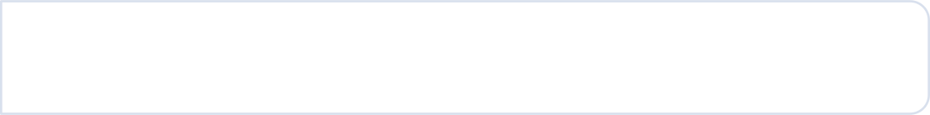

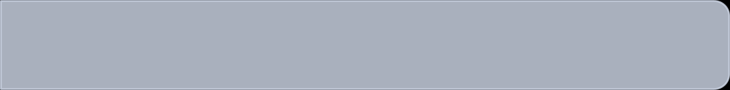
Team Roles
Doaa Fathi
- Team Leader - Designing & preparing the presentation
- Making strategy, tactics and control -Design posts & Ads campaign
Heba Ahmed
- Content Calendar and Content Creation
- Designing posts and Ads campaign
Yassmin Nassar
- Competitors Analysis - Business Model Canvas
- Designing posts and Ads campaign
Fatma Elkerdawy
- Content Calendar and Content Creation
- Designing posts and Ads campaign
Shaimaa Aly
- Buyer Persona - Business Model Canvas
- Designing posts and Ads campaign

Slide 8




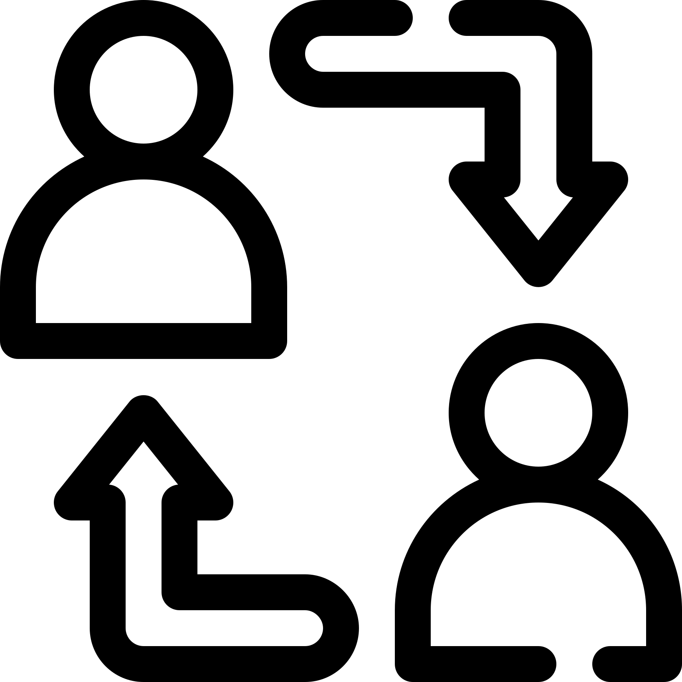

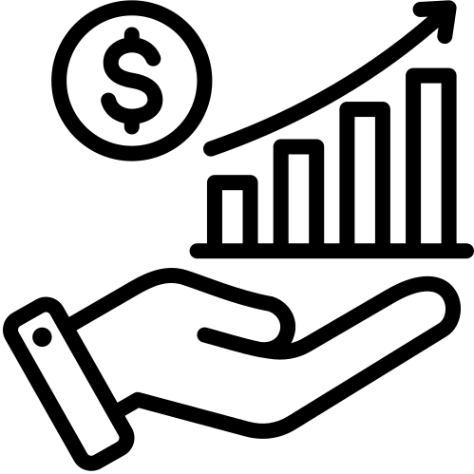

Business Model Canvas
Key Partner | Key Activity | Value Preposition | Customer relationship | Customer Segments
Health insurance companies. Suppliers of medical equipment and materials. Dental prosthetics manufacturing laboratories. Other medical clinics for mutual referrals | Dental diagnose & treatments. Surgery & Implant Cosmetic Health insurance companies. | Personalized ,painless dental experience with high technology. Online & phone booking. 100% Sterilization guarantee. Competitive prices and special offers with high quality services. | Visits to the clinic Engagement via social media & massage. | Individuals Families Children Elderly people Dental implant patients Health insurance companies
 | Key resources |  | Channels
 | Highly skilled professionals. Advanced equipment & devices Brand identity (social media & reputation). |  | Direct booking at the clinic . Social media platform (Facebook, Instagram). Clinic referral program
Cost Structure |  | Competitors | Revenue Stream
Salaries for doctors and staff Purchase and maintenance of dental equipment's Rent and operational facilities expenses Marketing, advertising, and promotional costs Procurement of medical and dental supplies Licensing, regulatory, and legal fees |  | Bassem El-Ashrafy Dental Clinic https://www.facebook.com/share/14nrquofW6/ Dr. Waleed Dental Clinic https://www.facebook.com/share/15BNF6pVz8 | Fees for services Medical corporate deals with companies. Cosmetic offers and smile makeover bundles
9

Slide 9
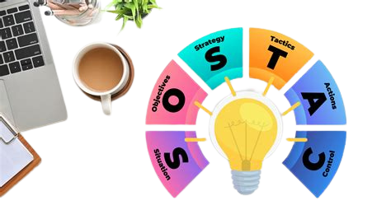
We used SOSTAC Marketing Model in this project

Slide 10
Situation Analysis
9

Slide 11




SWOT Analysis
STRENGTHS
WEAKNESS
Trusted dentist with over 30 years of experience.
Strong patient rapport and a wide range of high-quality services.
Limited marketing effort
Gaps in patients feedback
Never make life posts or videos
.
S
W
O
T
OPPORTUNITIES
THREATS
Digital marketing will build strong online presence to attract more patients
Retargeting patients by refreshing the presence on social media
High competition from clinics with lower prices or higher technology or promotion
Patients in medium-level areas migh prioress cost over quality

Slide 12
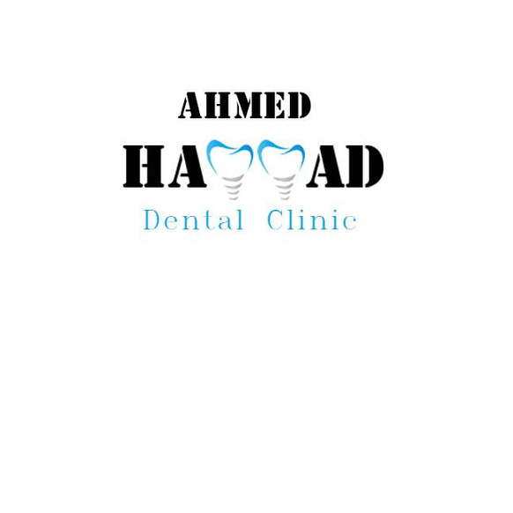



Competitor Analysis
Number of Experience Year | Clinic | Date of page creation
A qualified dentist with about 35 years experience |  | The page was created on June 2018
A qualified dentist with about 15 years experience. |  | The page was created on September 2023.
A qualified dentist with about 25 years experience |  | The page was created on April 2014
11

Slide 13



Competitor Analysis
Strengths
Balanced Content
Good Engagement.
Special Discounts.
Weakness
Moderate Posting Frequency but need to be regular
High pricing .
12

Slide 14
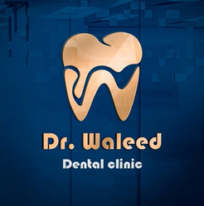
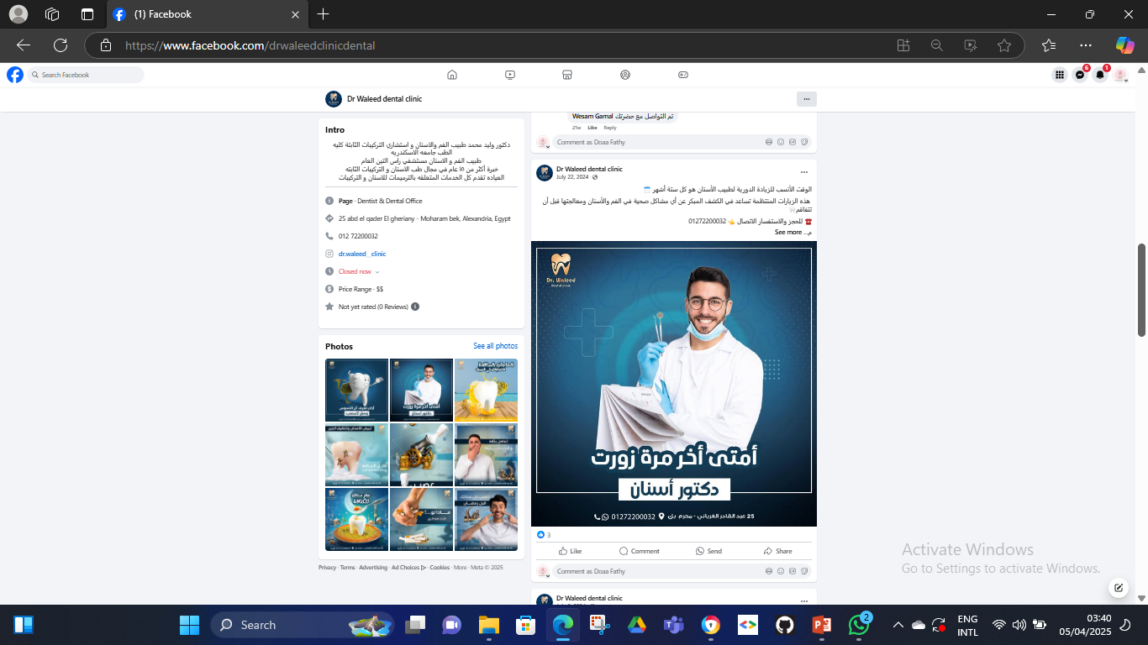
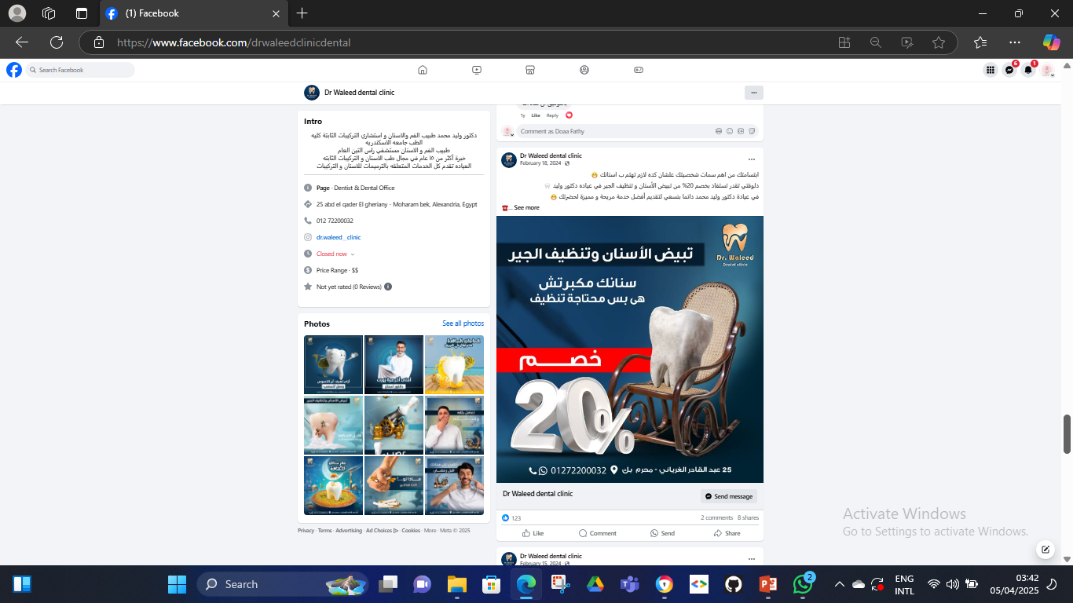
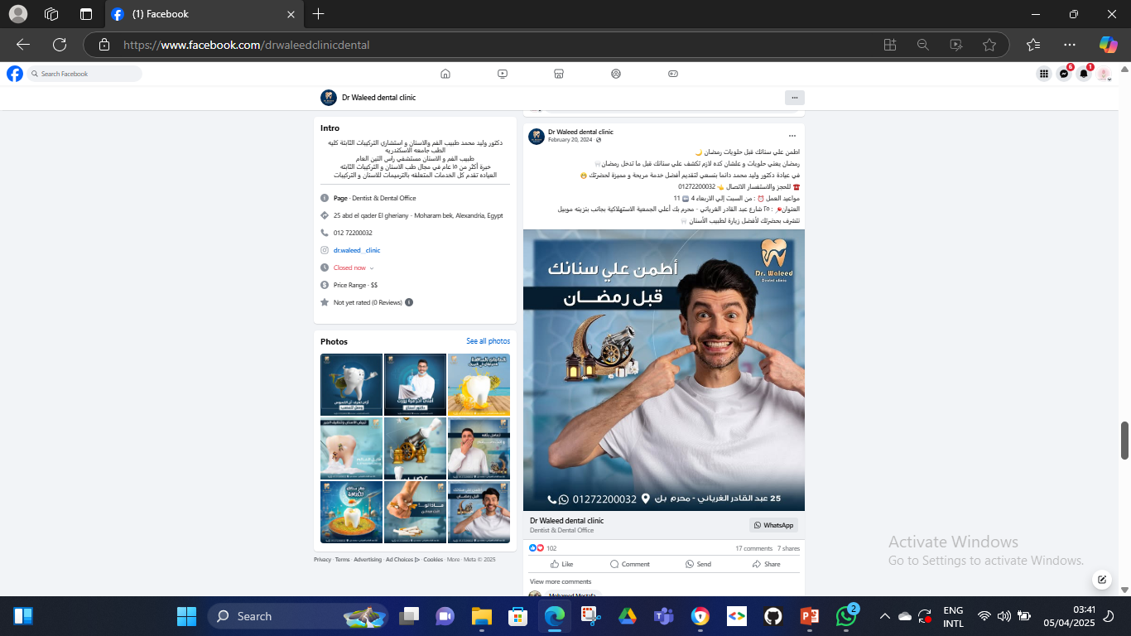
Competitor Analysis
13

Slide 15
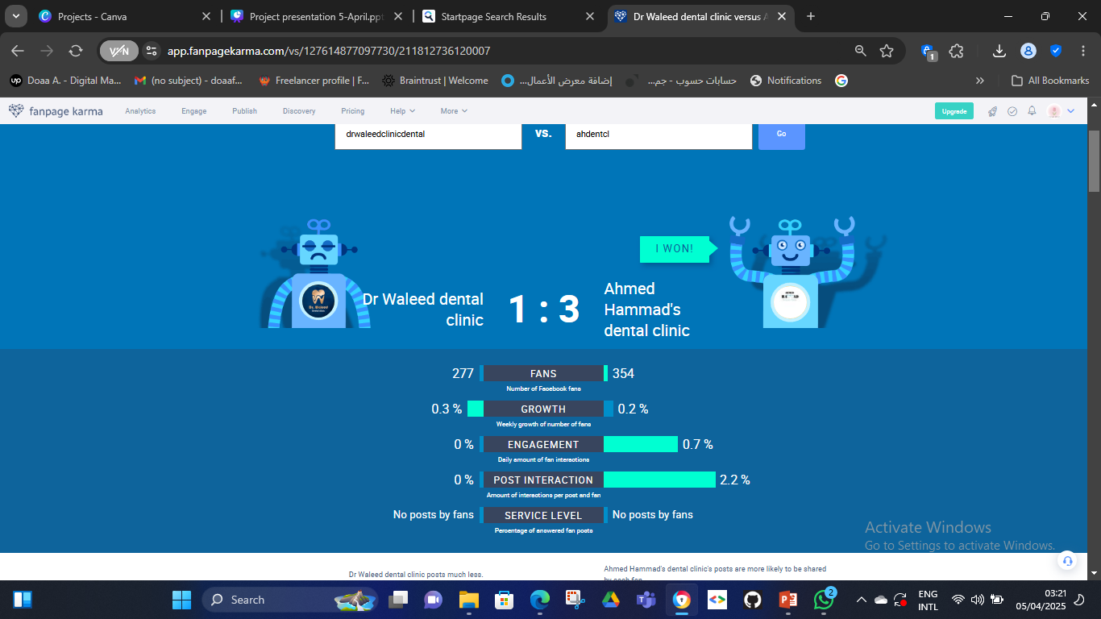
Competitor Analysis
14

Slide 16



Competitor Analysis
Strengths
Weakness
- High Engagement.
-Frequent Posting.
-Doctor has another
clinic in Turkey.
-Over posting.
-No direct contact.
-No patients review.
-High services price.
15

Slide 17

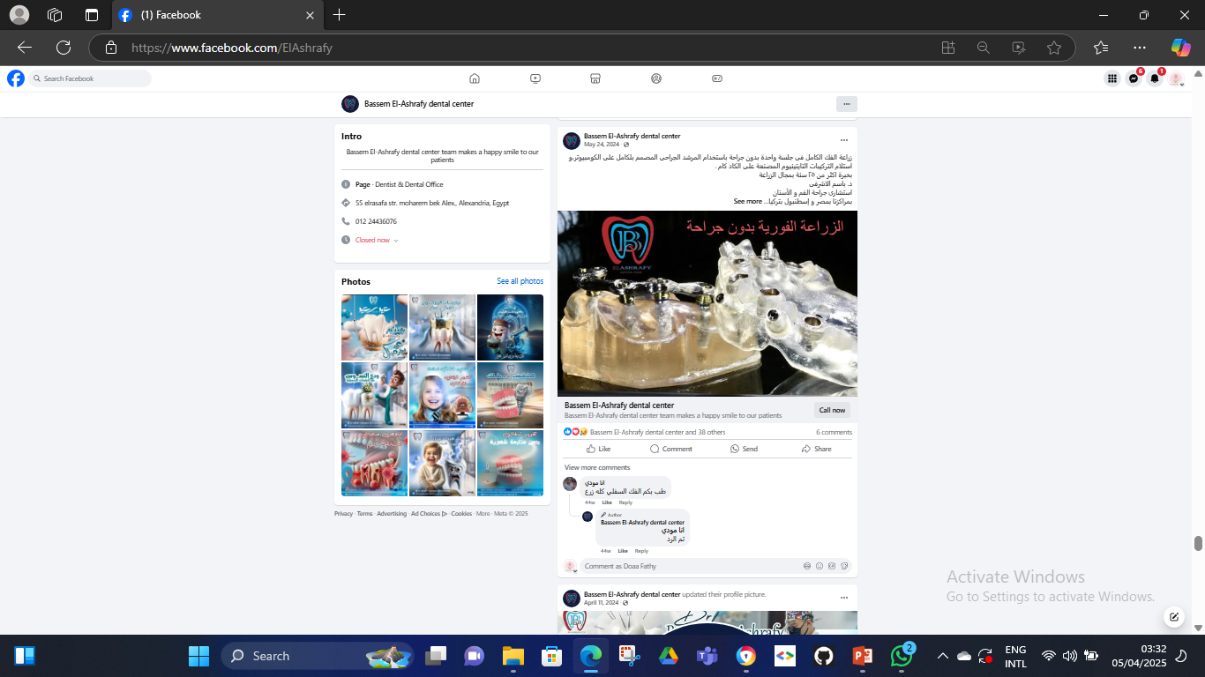
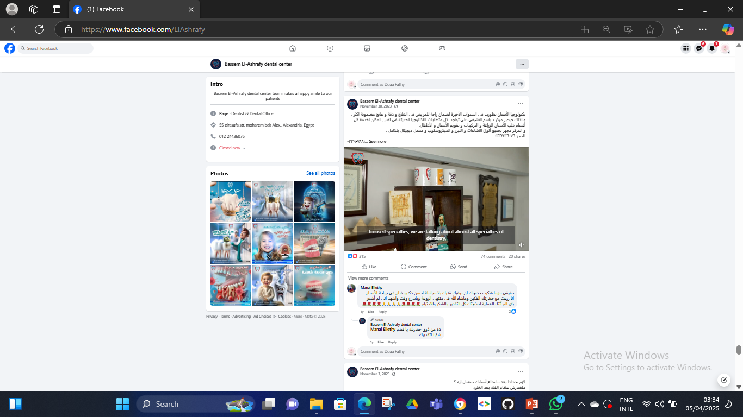
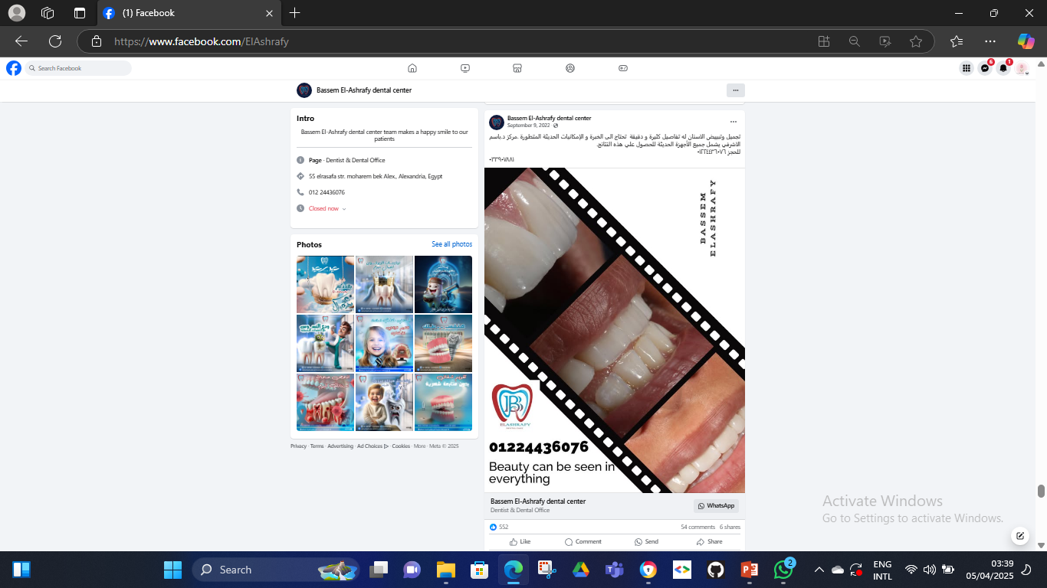
Competitor Analysis
16

Slide 18
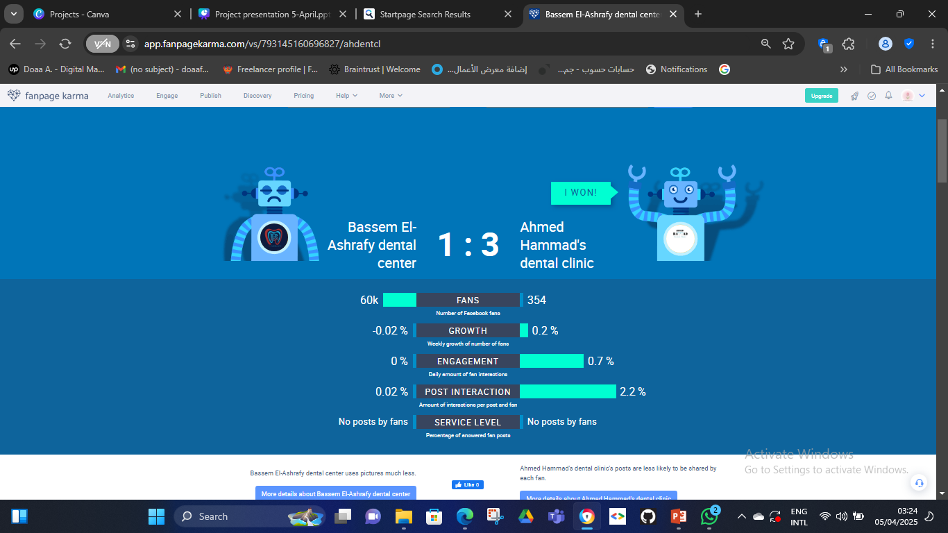

Competitor Analysis
17

Slide 19



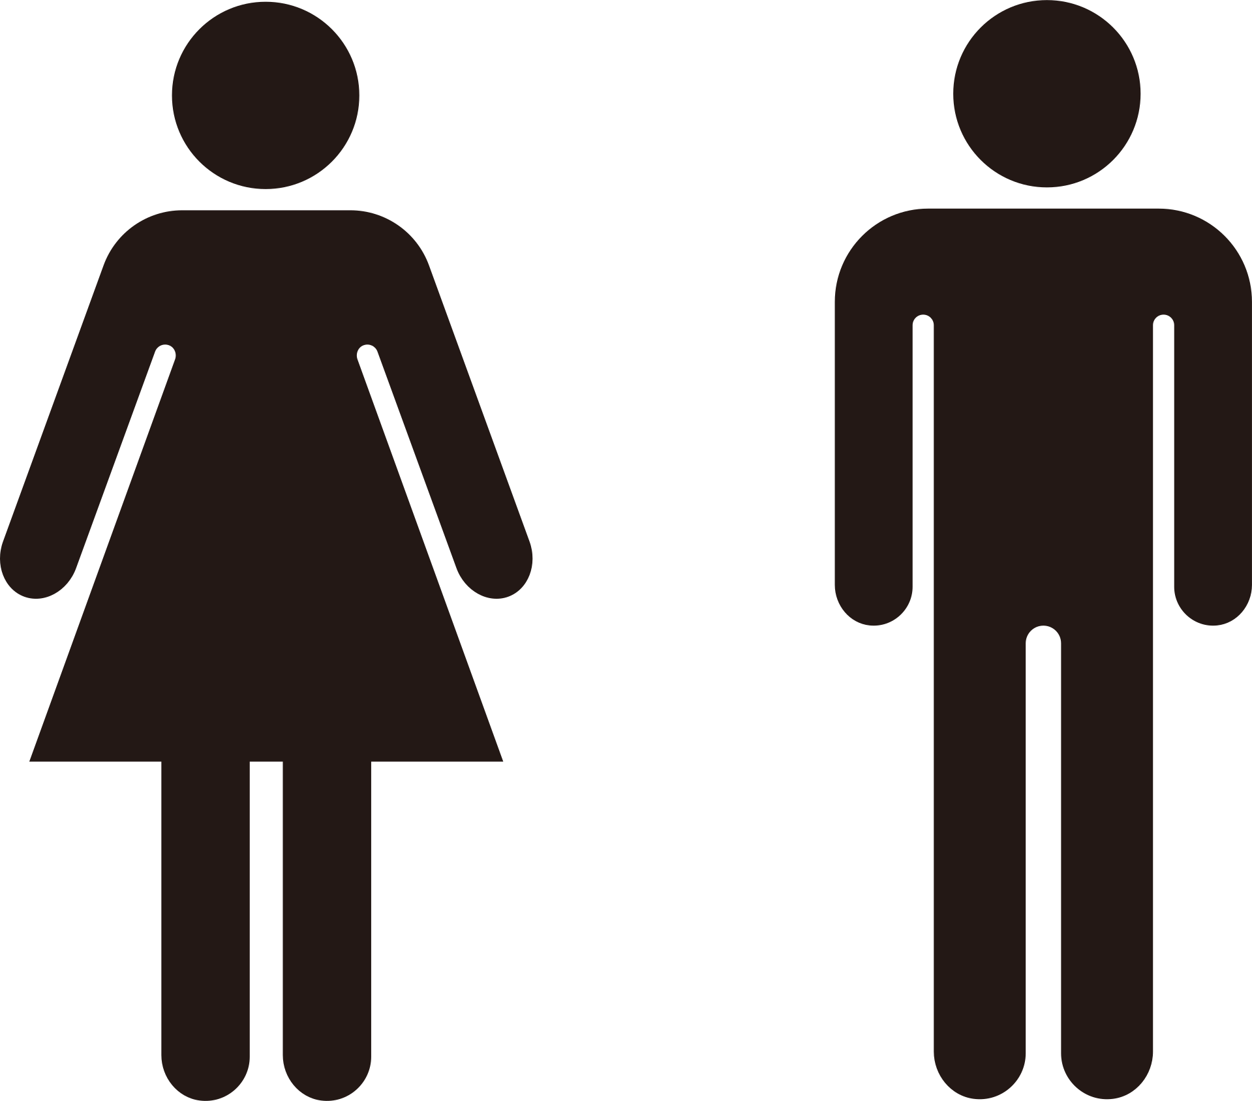






Customers Analysis
According to the market and audience analysis of the clinics in Alexandria we found that customers include all males and females , single and married , age from 18-60 years
18
Single
Married
Males and females
Teenage
Adults
Elders

Slide 20
Objectives
19

Slide 21





Objectives
Increasing brand awareness by 30% in the next 3 months through digital marketing platforms.
Increase revenue by 15% within the next 3 months by promoting high-value services (e.g., implants, cosmetic dentistry).
20
Aim to increase patient visits by 20% in the next 12 months by new patients and retargeting previous patients

Slide 22
Strategy
21

Slide 23

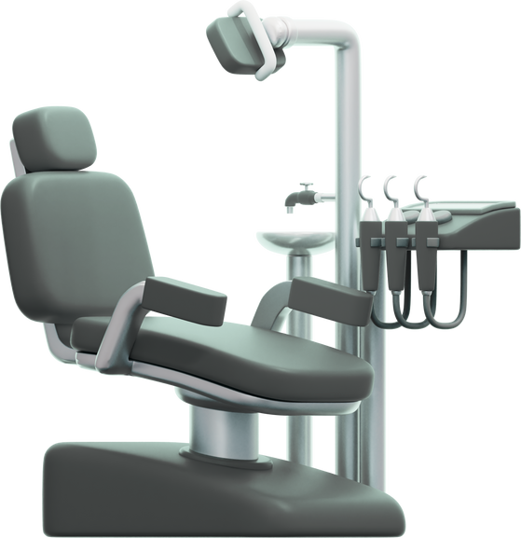


Unique Selling Point
Experience + Modern equipment + Affordable prices
22

Slide 24


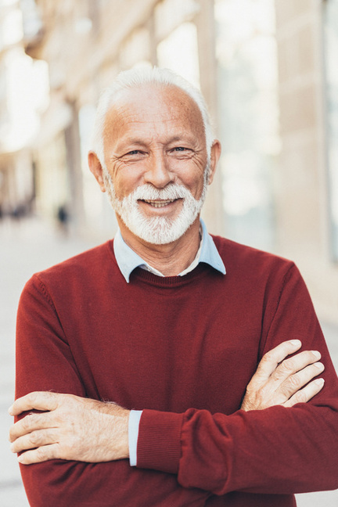




Buyer Persona
Bio: Khaled is in his sixties, retired and takes care of his health. He prefers experienced dentists, looks for special offers for the elderly, and looks for clinics that have contracts with insurance companies.
Goal: He want to maintain good dental health and get good health care
He is looking for a clinic that offers specialized services for the elderly.
23
Challenges: He may have some concerns about visiting the dentist
He search for a clinic close to his home.
KHALED
Retired Engineer
Pain points: He suffers from diabetes and the complications associated with tooth extraction. He wishes to replace these teeth but is uncertain about whether to choose commercial implants or fixed bridge

Slide 25
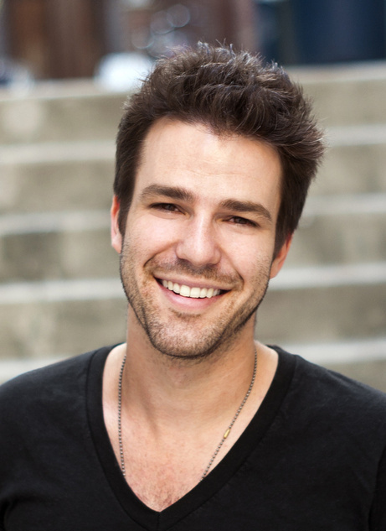
Buyer Persona
Bio: Ali is in his twenties, single uses Facebook to search for clinics, looks for offers and discounts, reads reviews, prefers to book online, and is influenced by friends’ recommendations.
Goal: Wanting to have an attractive smile to boost his self-confidence in social relationships, he is looking for a clinic that offers special offers for students.
24
Challenges: He dental health in general but may procrastinate visiting the doctor due cares about his to costs or fear. He has a limited budget. He prefers clinics that offer installments. He is looking for a clinic close to the university..
Ali
College Student
Pain points: Searching for good services with affordable price and flexible time
Need Orthodontic to get more arranged teeth look

Slide 26
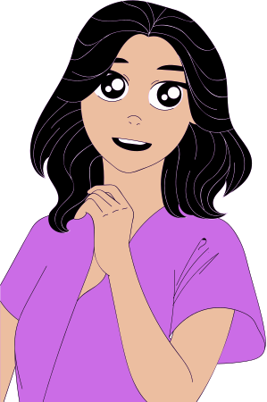
Buyer Persona
Bio: Nadia is 40s,a mother of four. She is graduated from university and she searches for clinics on Facebook. Prefer those that provide quick and efficient services. She compares prices, prefers to book by phone
Goal: She has time constraints, is looking for a clinic that is close to home and fits her budget, and prefers clinics that provide services for children
25
Challenges: She cares about her family's health, has regular checkups, and is looking for a clinic that provides comprehensive care for all family members
Nadia
A mother
Pain points: She always has a fear of dental clinics that do not apply infection control standards, so she wants a clinic that applies infection control standards to preserve the health of her children.

Slide 27

Buyer Persona
Bio: He is 20s concerned about his physical health, searches for information online, prefers clinics that use the latest technology and flexible appointments.
Goal: He may have damaged teeth due to playing sports, he is looking for a clinic that provides emergency services, preferably clinics located near training locations
26
Challenges: Wants to maintain oral health to ensure excellent athletic performance, looks for quick and effective solutions, may have a busy training schedule..
SAMEH
Pain points: He has sustained a broken tooth while exercising and seeks to obtain a crown that is both affordable and Looks natural.
Athlete

Slide 28
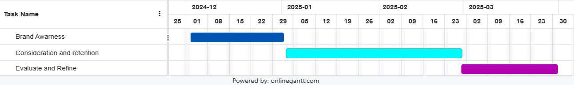
GANNT Chart
27

Slide 29







Strategy Timeline
Phase 2
(2nd and 3rd month)
Phase 3
(3rd month)
Phase 1
(1st month)
Focus on patient interest and consideration strategies, and growing the clinic’s reputation and retention through patient reviews, educational and promotional and before and after posts
Evaluate the success of the marketing tactics and refine them based on patient feedback and marketing metrics.
Focus on brand awareness building a strong online presence through Educational and promotions contents
28

Slide 30
Tactics
29

Slide 31

Digital Platforms
According to the market and audience analysis of the clinics in Alexandria we found that most patients search for dentists mostly on Facebook and sometimes on Instagram
Facebook
Instagram
30
https://www.instagram.com/ahmed.hammad.dentalclinic?igsh=MXJmOWQ5b2lremFyYg==
https://www.facebook.com/ahdentcl

Slide 32





Advertisement
Budget
We defined the budget for the ads with 1000 LE divided into 2 ads types
Awareness
Engagement
To increase awareness of the clinic name and location with educational posts
31
To increase the number of followers and likes to the page and retain the old patients.

Slide 33
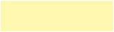
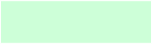

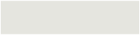

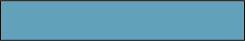
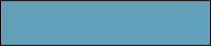
Content Calendar
DECEMBER
Saturday | Sunday | Monday | Tuesday | Wednesday | Thursday | Friday
 | فيديو جير الأسنان ومضاعفاته | 2 | 3 | خصم خاص علي التبييض | ضرس العقل ومشاكله | فيديو حالة مريض قبل وبعد
أسباب نزيف اللثة | 8 | أسنان الأطفال والاهتمام بها | بوست دعائي زراعة الاسنان | 11 | ليه لاوم تركب بعد الخلع | 13
ضحكتك حتنور التركيبات الثابتة | 15 | 16 | تركيب فص هدية مع التبييض | خصم 20% علي جميع الخدمات | فيديو بخدمات العيادة | تخصصات العيادة
مشاكل خلع الاسنان لكبار السن | 22 | حقائق واكاذيب عن طب الاسنان | ألم العصب | 25 | حقائق وااذيب عن طب الاسنان | 27
28 | سكرك مضبوط سنانك مضبوطة | تهنئة بالعام الجديد | 31
32
CONTENT TYPE
PLATFORM
Educational
Promotional
Facts and Myth
testimonial
Before and After
Faceboook
Instagram

Slide 34
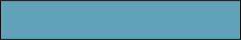
Content Calendar
JANUARY
Saturday | Sunday | Monday | Tuesday | Wednesday | Thursday | Friday
 |  |  |  | 1 | المضادات الحيوية وتاثيرها علي الاسنان | 3
حساسية الأسنان | 5 | معلومة سريعة | 7 | 8 | حقائق واكاذيب | 10
زراعة الأسنان ومميزاتها | 12 | فيديو عن تنظيف الأسنان | 14 | 15 | فطريات الفم وعلاجها | 17
الحشوات التجميلية | 19 | أمتي الاسنان اللبنية بتتبدل | 21 | 22 | المخاوف من طبيب الأسنان | 24
الغلورايد والمعجون | 26 | 27 | 28 | 29 | 30 | 31
33
CONTENT TYPE
PLATFORM
Educational
Promotional
Facts and Myth
testimonial
Before and After
Faceboook
Instagram

Slide 35
Content Calendar
FEBRUARY
Saturday | Sunday | Monday | Tuesday | Wednesday | Thursday | Friday
التركيبات المتحركة ومميزاتها | 2 | 3 | فيديو حالة قبل وبعد | 5 | تسوس اسنان الأطفال | 7
حساسية الأسنان | 9 | 10 | تركيب فص هديه مع التبييض | 12 | ريفيو من مريض سابق | 14
فيديو طريقة غسل الأسنان | 16 | 17 | صورة لعيادة والدكتور | 19 | حقيقة واكاذيب | 21
تركيبات الاسنان | 23 | 24 | حشو الليزر | 26 | الأمراض العضويه التى تؤثر على صحة الأسنان واللثة | 28
34
CONTENT TYPE
PLATFORM
Educational
Promotional
Facts and Myth
testimonial
Before and After
Faceboook
Instagram

Slide 36
Content Calendar
March
Saturday | Sunday | Monday | Tuesday | Wednesday | Thursday | Friday
فيديو تهنئه رمضان | 2 | 3 | لو اسنانك تقدر تتكلم هتقول ايه؟ | اسباب غريبه لتسوس الاسنان | 6 | سؤال كتير جالنا
8 | حقيقه واكاذيب | 10 | 11 | عارف اصعب موقف ف رمضان ايه ؟ | 13 | 14
15 | الفنيير | 16 | Engagement Ads | Engagement Ads | Engagement Ads | جبت هديه عيد الام ولا لسه؟
22 | تخيل إن أمراض الكلى ممكن تأثر على اسنانك | 24 | هل بنج الأسنان خطر على الحامل | إنذار رسمى لعشاق القهوة | العيد قرب والمناسبات تكتر | 28
29 | فيديو تهنئة عيد الفطر | 31
35
CONTENT TYPE
PLATFORM
Educational
Promotional
Facts and Myth
testimonial
Before and After
Faceboook
Instagram

Slide 37
Actions
36

Slide 38
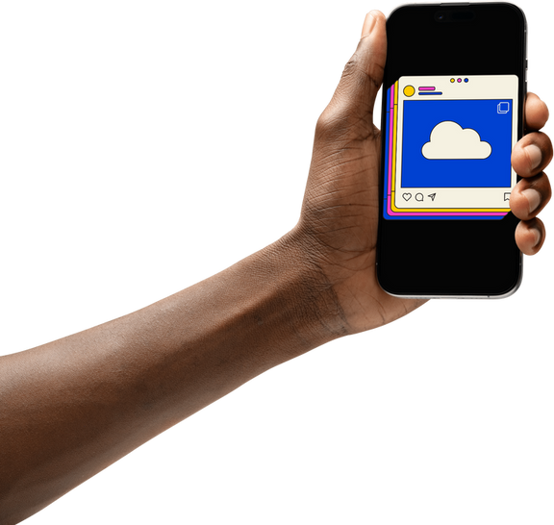
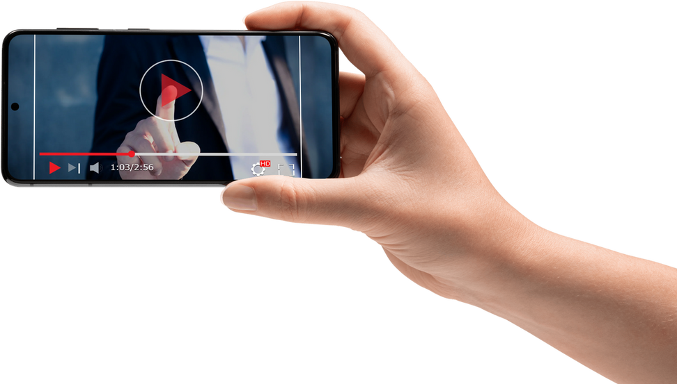
Posts Types
37
Our posts include image posts ,reels , stories and videos
Each type of them include educational, promotional before/after and testimonial.

Slide 39

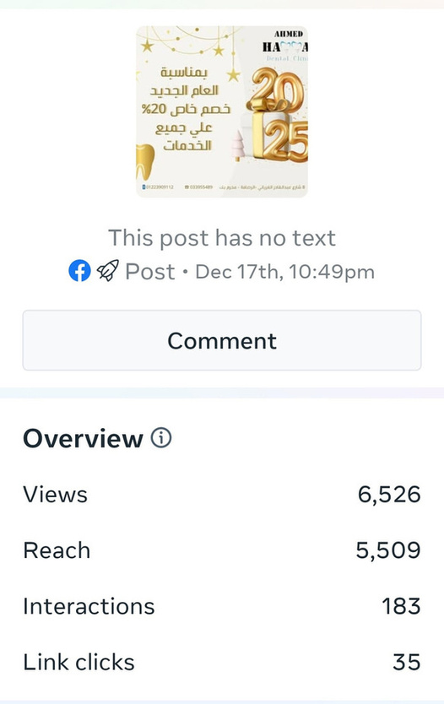
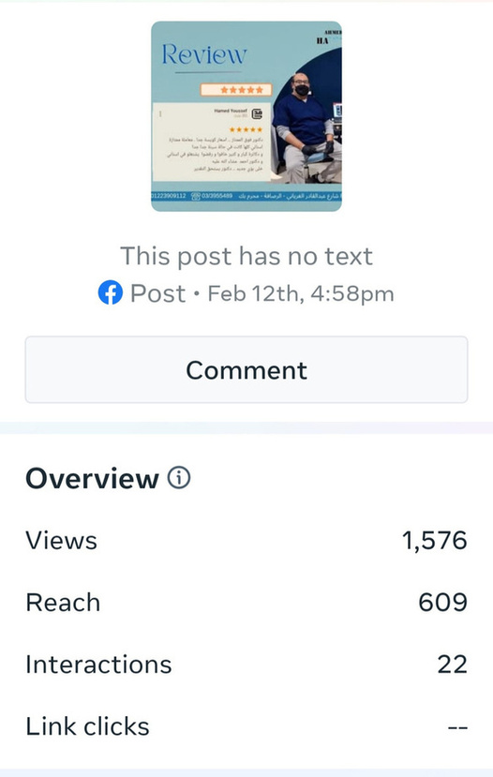
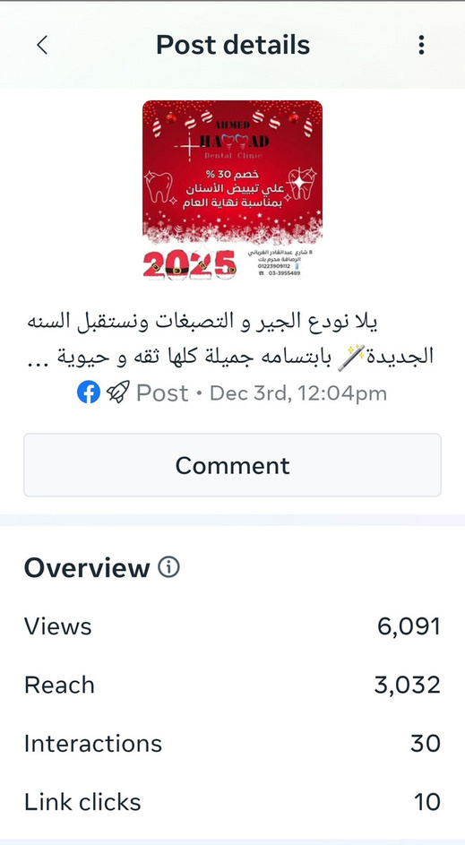
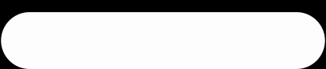

Posts Sample
38
PROMOTIONAL
TESTIMONIAL
PROMOTIONAL

Slide 40







Posts Sample
39
EDUCATIONAL
EDUCATIONAL
PROMOTIONAL

Slide 41



Content Samples
40

Slide 42





Reels and stories Samples
41
Before and after posts were published on facebook and instagram as posts, reels and stories

Slide 43

Videos Sample
42

Slide 44
Control
43

Slide 45





Page Performance
We measured the performance of the strategy by measuring KPIs as follow:
Brand
awareness
Page follows
Page likes
Content interaction and views
Increase
revenue
Messages and response
44
Increase
patients
Messages and response

Slide 46

Brand awareness KPIs
The graph shows the increase in number of followers and likes during the period 1/12/24 – 31/3/25
45

Slide 47

Brand awareness KPIs
The graph shows the number of views and reach during the period
1/12/24 – 31/3/25
45

Slide 48

Revenue KPI
The graph shows the number of messages during the period 1/12/24 – 31/3/25
In addition to average 5 new patients visit the clinic monthly throughout the page with total 20 patients in 4 months
45

Slide 49
CAMPAIGN MANAGMENT
48

Slide 50

Ads Campaign
Our Campaign was divided into 2 types
Engagement
Awareness
Post Engagement
Page Likes
Page Engagement
Calls

Slide 51

Page Engagement Ads
Cost: 250 L.E.
View | 1850
Reach | 1369
Page Likes | 118
45

Slide 52

Post Engagement Ads
Cost: 500 L.E.
View | 10395
Reach | 8506
Post Likes | 347
45

Slide 53

Page likes Ads
Cost: 100 L.E.
View | 2752
Reach | 2392
Page Likes | 74
45

Slide 54

Calls Ads
Cost: 140 L.E.
View | 5531
Reach | 3057
Calls | 8
45

Slide 55

Interaction Overview
The overview reaction with the page during the period 1/12/2024 – 31/3/2025
View | 39.3 K
Reach | 16.6 K
3 sec. view | 1.6 K
Interaction | 1.2 K
48 % organic 52% Ads
45

Slide 56
Recommendations
48

Slide 57

Recommendations
Based on the results observed from the plan implanted between 1/12/24 – 31/3/25, we recommended the following actions:
1- Increase the number of interactive posts on the page, including videos featuring the doctor and live sessions to address audience questions.
2- Encourage patients to write reviews and testimonials on the page to boost trust and credibility in the clinic
3- Create a simple questionnaire to identify how patients learned about the clinic, which will help assess the actual impact of the page on attracting new patients

Slide 58
Thanks

